Slide 1
XOR Gate Implementation using BJTs
Presented by:
Hassan Ali Ahmad NUM-BSEE-2023-03
Raheem Bakhsh NUM-BSEE-2023-10
Instructor: Ms. Zulaikha Kiran
Lab Engineer: Eng. Muhammad Imtiaz-Ul-Hassan

Slide 2
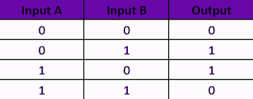
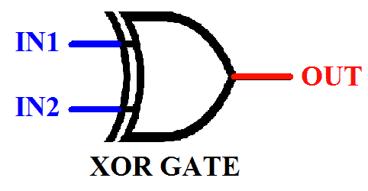
Introduction
XOR gate Symbol
XOR gate Truth Table

Slide 3
Implementation
Software
Hardware
Proteus
Proto
Five PN2222 Transistors
Resistors
Power Supply (8V)
Breadboard
Connecting Wires

Slide 4
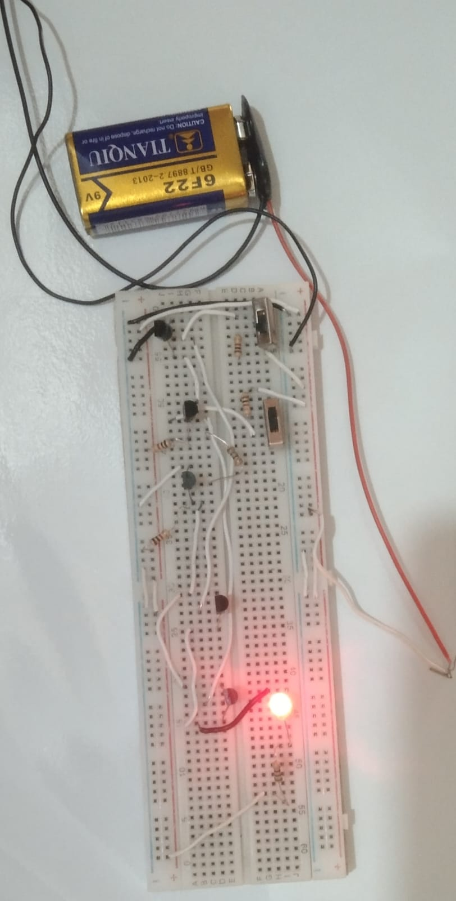
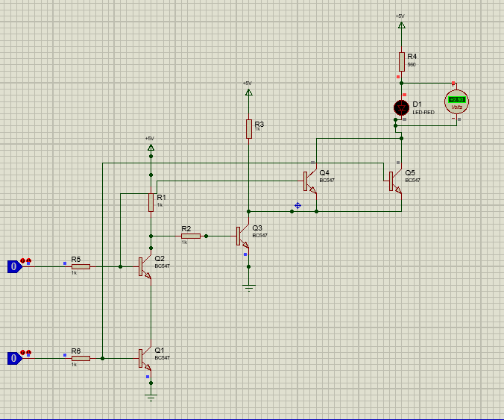
Circuit Diagram
Hardware Implementation
Software Implementation
4

Slide 5
Circuit Operations
1
Case 1
2
Case 2
Input A = 0, B = 0 → Output = 0
Input A = 1, B = 0 → Output = 1
3
Case 3
4
Case 4
Input A = 0, B = 1→ Output = 1
Input A = 1, B = 1→ Output = 0

Slide 6

Case Analysis
Case 1
Cutoff Region
saturation Region
Q1,Q2,Q4,Q5
Q3
Output
LED Off

Slide 7
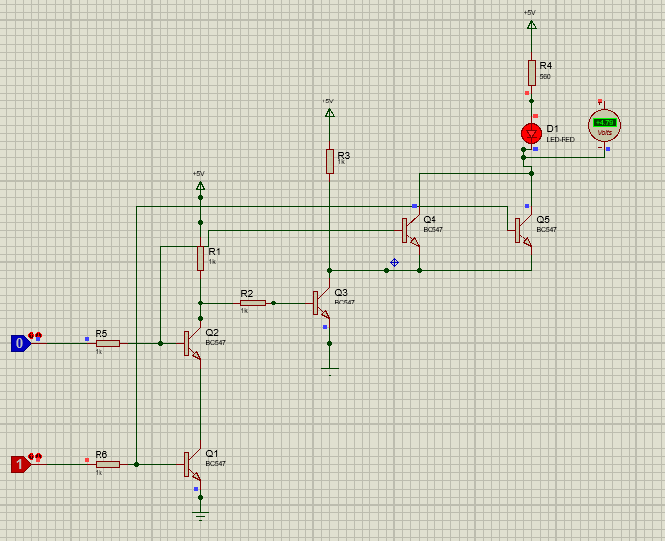

Case Analysis
Case 2
Cutoff Region
saturation Region
Q2,Q4
Q1,Q3,Q5
Output
LED ON

Slide 8
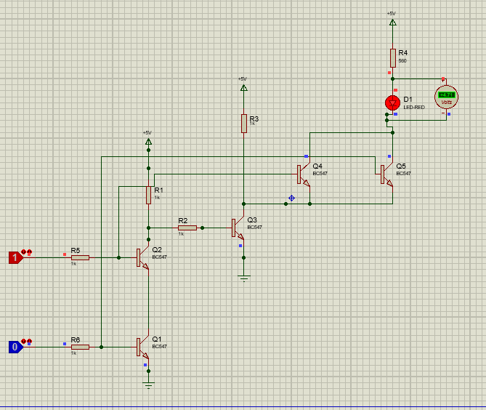
Case Analysis
Case 3
Cutoff Region
saturation Region
Q1,Q2,Q4
Q3,Q5
Output
LED ON

Slide 9
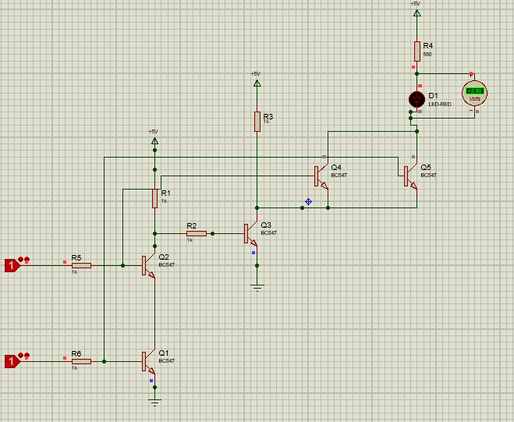
Case Analysis
Case 4
Cutoff Region
saturation Region
Q3
Q1,Q2, Q4,Q5
Output
LED Off

Slide 10
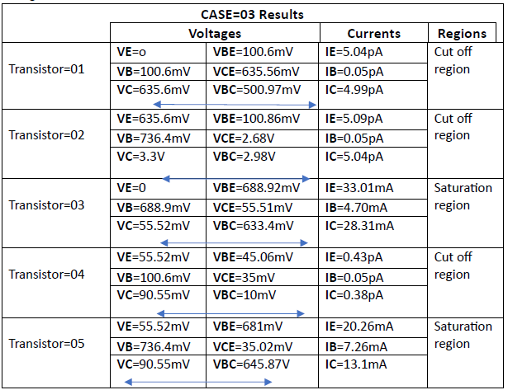
Case 3 Results

Slide 11
Conclusion
The XOR gate implementation using BJTs effectively fulfills the XOR gate truth table. This gate can be used as Comparator. The circuit's behavior was validated through both software simulation and hardware implementation.

Slide 12
References
https://www.youtube.com/watch?v=sTu3LwpF6XI&t=660s&pp=ygUlaG93IHRvIG1ha2UgeG9yIGdhdGUgdXNpbmcgdHJhbnNpc3Rvcg%3D%3D
https://www.gsnetwork.com/xor-gate/

Slide 13
Thank You

